Slide 1

Roll No.-21MTechIT05
Experimental Analysis of different Deep Learning Techniques for SAR Images Classification
Presented By
Chlangdiam Sumer
(21MTechIT05)
Under the supervision of
Prof. Debdatta Kandar
Department of Information Technology School of Technology North-Eastern Hill University, Shillong

Slide 2
Roll No.-21MTechIT05
CONTENT
Introduction
Motivation
Objective
Existing Work
Methodology
Analysis of different DL models
Dataset Used
Implementation
Observation
Discussion
Experimental Result & Analysis
Conclusion
References

Slide 3
INTRODUCTION
Roll No.-21MTechIT05
Synthetic Aperture Radar (SAR)
SAR is a form of radar, used to create 2-D/3-D reconstructions of objects
A technique for generating high resolution images and one of the powerful tools of remote sensing.
SAR is independent of flight altitude and weather.
It is typically mounted on a moving platform, such as aircraft or spacecraft.
It is a 24-hour active, all weather technology.
SAR images have wide applications in remote sensing and mapping the surfaces of the Earth and other planets.
SAR technology provides terrain structural information, oil spill boundaries on water, sea state and ice hazard maps, and reconnaissance and targeting information.
Advantage: It can synthetically produce higher resolution images in any weather condition as it is less affected by weather, illumination and other conditions.
Notes:
SAR images are formed when the microwave are bounce from a surface of an object.
(SAR) refers to a technique for producing fine resolution images from a resolution-limited radar system and it is one of the power tools of remote sensing.

Slide 4
MOTIVATION
Roll No.-21MTechIT05
Misclassification is a major problem in SAR image classification due to the complexity, coarseness, and presence of unwanted features.
Therefore identifying which target or image scene falls under which class is complex and hence challenging.
Deep learning has made significant advances in a variety of areas, including speech recognition, object detection, and image classification.
Deep learning in remote sensing is now obtaining a lot of attention due to its many successful applications in the computer vision community
This motivates us to choose some DNN models and analyze their performance on SAR image.
Notes:
One of major issues related to classification of SAR images is the misclassification issue. Such issues hesitate the application of SAR images in real-life applications
Misclassification mainly caused due to the high complexity and coarseness of the images obtained from SAR, along with the presence of unwanted features.
Even though substantial noise suppression techniques have been brought forward to remove noise from SAR images, sometimes the noise removal techniques tends to remove even some of the important features which give rise to improper classification.
Therefore identifying which target or image scene falls under which class is complex and hence challenging.
In recent years, deep learning has advanced dramatically, achieving considerable success in a variety of areas such as speech recognition, object detection and image classification etc.
Compared to traditional algorithms, deep learning-based approaches frequently employ hierarchical concepts, such as deep neural networks, to extract feature representations of raw data for a number of purposes.
Deep learning in remote sensing is now obtaining a lot of attention due to its many successful applications in the computer vision community
CNN, on the other hand, is one of the most popular deep learning method in the areas of image and speech processing

Slide 5
OBJECTIVE
Roll No.-21MTechIT05
The primary objective is:
To classify SAR images using different Deep Learning techniques/models.
10 different DNN models will be choose and analyze their performance.
Each model will be compared to one another according to their performance.
The model with best performance will be choose and further improvement will be made on it by modify it architecture.

Slide 6
EXISTING WORKS
Roll No.-21MTechIT05
PAPER | AUTHOR | YEAR | STRATEGY
A Deep Learning Fusion Recognition Method Based on SAR Image Data | Zhai Jia et al. | 2019 | Extracting 1-D features with principle component analysis (PCA), stacked autoencoder (SAE) network to extract deep features for target recognition
Deep Learning for SAR Image Classification | Hasni Anas et al. | 2020 | Pre-trained VGG-16 are fine-tuned
A Deep Learning SAR Target Classification Experiment on MSTAR Dataset | Cristian Coman et al. | 2018 | Analyze the potential of using additional radar information, new method is proposed for the problem of automated target recognition (ATR) in SAR.
Notes:
Accuracy: 93.39%
Accuracy: 87.96%
Accuracy: 91%

Slide 7
EXISTING WORKS
Roll No.-21MTechIT05
PAPER | AUTHOR | YEAR | STRATEGY
A CNN Based Approach for SAR Image Classification of Vehicles | Abhishek Ameta et al. | 2020 | Classified, recognized and detected military vehicles with the help of CNN algorithm where PCA is used to extract 1-D features
Target Detection and Recognition Based on Convolutional Neural Network for SAR Image | YanPing Wang et al. | 2018 | CNN model is used to conduct target detection and recognition experiment on the moving and stationary target acquisition and recognition (MSTAR) benchmark dataset.
Notes:
Accuracy: 94.06%
Accuracy: 96.4%

Slide 8
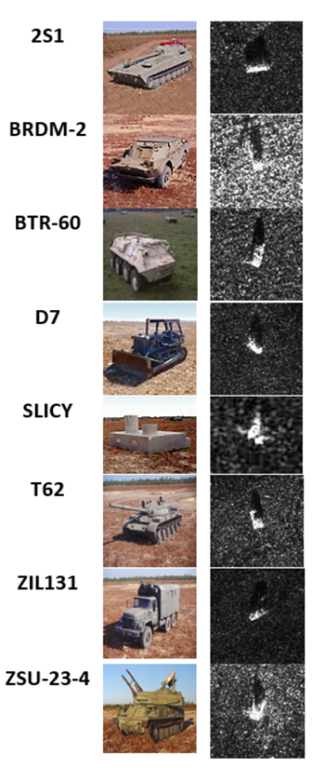
DATASET USED
Roll No.-21MTechIT05
Publicly available MSTAR SAR images dataset produced by Defense Advanced Research Projects Agency (DARPA) and Air Force Research Labs are used which was download from Kaggle website.
The dataset consist of 8 classes of different ground military target (2S1, BDRM-2, BTR-60, D7, SLICY, T62, ZIL-131, ZSU-23-4).
It has 9466 total images which includes 6623 for train set, 1890 for validation set and 953 for test set.
The image resolution is 368 x 368 pixels.
Fig. Visual samples from data
(Source: Classification of Images Obtained by SAR)
Notes:
2S1(Self-propelled artillery) ,
BDRM-2(Armoured Scout Car),
BTR-60(Armoured Personal Carrier),
D7(Caterpillar Bulldozer),
SLICY(Structure acting as 'Ground Truth’),
T62(Main battle tank), ZIL-131(Military Cargo truck)
ZSU-23-4(Self-Propelled anti-aircraft).

Slide 9
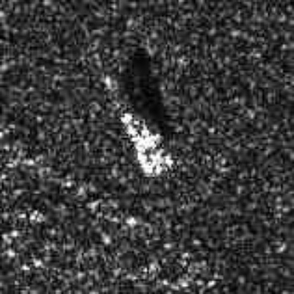
METHODOLOGY
Roll No.-21MTechIT05
CNN Architecture
2S1
BRDM-2
BTR-60
D7
SLICY
T72
ZIL-131
ZSU-23-4
SoftMax Layer
Models
SF
maxPoolingLayer
ImageInputLayer
convolutionLayer
fullyConnectedLayer
Fig: General CNN Structure
Notes:
Step Involves:
Data Collection
Analysis the performance of 10 DNN models
Each model is train and Evaluate
Result Analysis
Comparison of each model
Pooling helps to make the network more robust to small variations in the input data and reduces the number of parameters in the network.
Each neuron in the fully connected layer is connected to every neuron in the previous layer

Slide 10
METHODOLOGY
Roll No.-21MTechIT05
CNN Architecture
Input Layer: The data is first adjusted by resizing and then transmitted to the network for processing through this layer.
Convolution Layer : This layer basically filters the input images through the use of convolution kernels composed of parameters to be optimized during the training.
Pooling Layer: It is the layer in which a specific element is picked while all others are eliminated in the sub-matrix of the incoming image.
Fully Connected Layer: All the previous layers’ output represents the high-level properties of the input image, and the purpose of the fully connected layer is to connect each class with each of these properties
Notes:
Pooling helps to make the network more robust to small variations in the input data and reduces the number of parameters in the network.

Slide 11
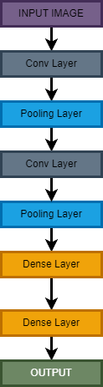
ANALYSIS OF DIFFERENT MODELS
Roll No.-21MTechIT05
LeNet
LeNet was one of the oldest model and popular Deep Learning model which was introduced by Albawi et al.
LeNet has simple and few layers architecture which make it fast to compute.
It has 2 convolutional layers, each followed by pooling layer. These convolutional layers have different filters sizes and extract features from input images.
The pooling layers help to down-sample the feature maps generated by the convolutional layers. Reducing the dimensionality of the data while retaining the important features.
Finally, the layers are connected with the full connected layer(Dense layer) where all the neurons are interconnected.
The output of the final layer is passed through a softmax activation function.
Fig. LeNet Model Architecture
Notes:
The typical filter sizes used in LeNet are 5x5 and 3x3, with a stride of 1.

Slide 12
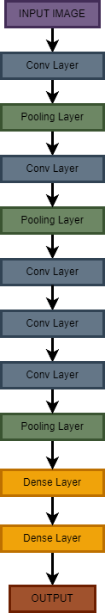
Roll No.-21MTechIT05
AlexNet
AlexNet was primarily design by Alex Krizhevsky. The first CNN to used GPU boost performance.
It has won the LSVRC in 2012 conducted by ImageNet
Most elements of AlexNet are almost the same compared to LeNet model.
AlexNet consists of 5 convolutional layers, 3 maxpooling layers and 2 FCC followed by the output layer.
The output of the final layer is passed through a SoftMax activation function.
To minimize the over-fitting problem AlexNet used the concept of Dropout and Batch-Normalization layers.
Fig. AlexNet Model Architecture

Slide 13
Roll No.-21MTechIT05
VGG-16
VGG-16 was developed by the Visual Geometry Group at the University of Oxford.
Widely used CNN architecture for image classification tasks.
VGG-16 architecture consists of 13 convolutional layers and 3 dense layers, with a total of 16 layers.
The first few layers are convolutional layers, followed by a max pooling layer
After the convolutional layers, the output is flattened and passed through 3 dense layers.
The output of the final layer is passed through a softmax activation function.
Conv Layer
Conv Layer
Conv Layer
Conv Layer
Conv Layer
Conv Layer
Conv Layer
Conv Layer
Conv Layer
Conv Layer
Conv Layer
Conv Layer
INPUT
Conv Layer
Dense Layer
Dense Layer
OUtPUT
Pooling Layer
Pooling Layer
Pooling Layer
Pooling Layer
Pooling Layer
Dense Layer
Fig. VGG16 Model Architecture
Notes:
Advantages:
The VGG architecture is relatively simple and easy to understand, consisting of a series of repeated blocks with small convolutional filters. (source: Simonyan and Zisserman, 2015)
Disadvantages:
The repeated blocks of the VGG architecture can lead to overfitting on small datasets

Slide 14
Roll No.-21MTechIT05
VGG-19
VGG-19 is another variant of VGG which is an extension of the VGG-16 architecture developed by the Visual Geometry Group at the University of Oxford.
Its architecture is similar to VGG-16, but it has 19 layers instead of 16. It consists of 16 convolutional layers and 3 dense layers.
After the convolutional layers, the output is flattened and passed through 3 dense layers.
The output of the final layer is passed through a softmax activation function.

Slide 15
Roll No.-21MTechIT05
MobileNet
MobileNet was designed for mobile and embedded devices with limited computational resources. It consists of a series of depthwise separable convolutional layers, which are a combination of a depthwise convolution layer and a pointwise convolution layer.
Depthwise convolution applies a single filter which reduces the computational cost of the network significantly
One main advantage of MobileNet is its small size and low computational cost.
The use of depthwise separable convolutional layers allows the network to achieve high accuracy with fewer parameters.
3x3 Conv
INPUT
BatchNorm
ReLu
3x3 DW Conv
BatchNorm
ReLu
3x3 DW Conv
1x1 Conv
MobileBlock
5, 3x3 DW Conv 5, 1x1 Conv
MobileBlock
MobileBlock
AvgPool
SoftMax
MobileBlock
Dense Layer
Fig. MobileBlock
Fig. MobileNet Model

Slide 16
Roll No.-21MTechIT05
MobileNet-V2
MobileNet is an evolution of the original Mobilenet architecture which follows almost the same architecture as V1.
It improves upon the original architetcture by introducing inverted residual blocks and linear bottlenecks components.
The depthwise convolution is followed by a linear pointwise convolution, which reduces the number of channels and acts as a bottleneck
MobileNetV2 typically includes a few additional layers, such as a 1x1 pointwise convolution and global average pooling

Slide 17
Roll No.-21MTechIT05
XceptionNet
XceptionNet short for Extreme Inception that was introduced by Chollet in 2017.
It was inspired from the InceptionNet architecture with the addition of new concept called depth-wise separable convolutional operations
The original depthwise separable convolution performs first the depthwise convolution followed by a pointwise convolution.
Depthwise convolution is the channel-wise n×n spatial convolution.
Pointwise convolution actually is the 1×1 convolution to change the dimension.
XceptionNet used the modified depthwise separable convolution which performs first the pointwise convolution followed by a depthwise convolution.
In XceptionNet there is no non-linearity after 1st operation as in InceptionNet.
Notes:
https://towardsdatascience.com/review-xception-with-depthwise-separable-convolution-better-than-inception-v3-image-dc967dd42568
Depthwise convolution is the channel-wise n×n spatial convolution.
Pointwise convolution actually is the 1×1 convolution to change the dimension.
the Xception without any intermediate activation has the highest accuracy

Slide 18
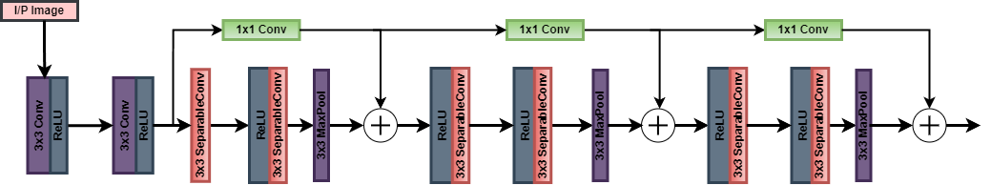
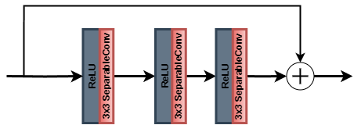
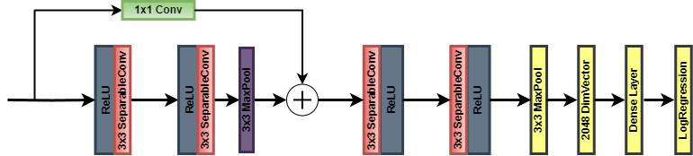
Roll No.-21MTechIT05
XceptionNet
Entry Flow
Middle Flow
Exit Flow
Fig. Architecture of XceptionNet model
Notes:
https://towardsdatascience.com/review-xception-with-depthwise-separable-convolution-better-than-inception-v3-image-dc967dd42568
Depthwise convolution is the channel-wise n×n spatial convolution.
Pointwise convolution actually is the 1×1 convolution to change the dimension.
the Xception without any intermediate activation has the highest accuracy

Slide 19
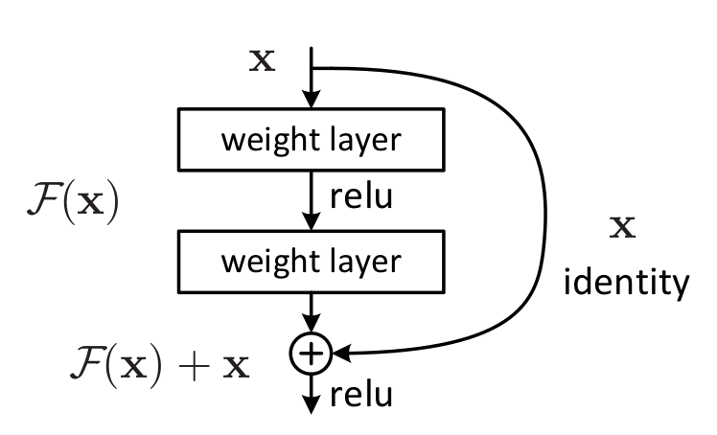
Roll No.-21MTechIT05
ResNet-50
To solve the issue of rapid saturation and degradation in accuracy a concept of Residual block is introduced.
The main concept is to provide a shortcut bridge for skipping/jumping one or more layers.
ResNet-50 is a variant of ResNet model which consists of 50 layers(48 Conv+1MaxPool+1AvgPool)
It consists of several residual block which help in training deep networks.
The ResNet-50 architecture, with its deep and residual connections, has been widely used for various computer vision tasks, including image classification, object detection, and image segmentation
Fig. Sample Residual block
Notes:
ResNet152-v2 is an extension of the ResNet architecture that has 152 layers and incorporates several improvements over the original ResNet architecture, such as using bottleneck blocks and pre-activation.
The architecture uses residual connections to skip over certain layers, which helps to mitigate the vanishing gradient problem that can occur in deep neural networks.
The ResNet152-v2 architecture is based on a building block called the bottleneck block, which is designed to reduce the number of parameters and computations required in the network. The

Slide 20
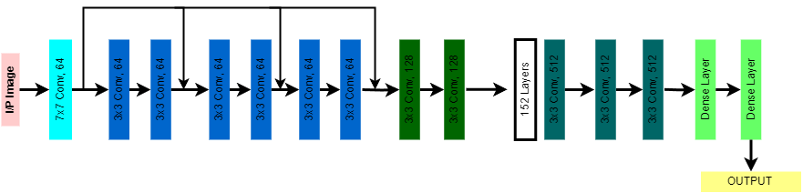
Roll No.-21MTechIT05
ResNet152v2
ResNet152-v2 is a variant of the ResNet architecture, which is a deep neural network architecture.
It is also an extension of the ResNet architecture that has 152 layers and incorporates several improvements over the original ResNet architecture.
The architecture uses residual connections to skip over certain layers which enable information to flow directly from the input to the output of the network.
The ResNet152-v2 architecture is based on a building block called the bottleneck block.
Fig. ResNet152v2 Model Architecture
Notes:
ResNet152-v2 is an extension of the ResNet architecture that has 152 layers and incorporates several improvements over the original ResNet architecture, such as using bottleneck blocks and pre-activation.
The architecture uses residual connections to skip over certain layers, which helps to mitigate the vanishing gradient problem that can occur in deep neural networks.
The ResNet152-v2 architecture is based on a building block called the bottleneck block, which is designed to reduce the number of parameters and computations required in the network. The

Slide 21
Roll No.-21MTechIT05
DenseNet-121
DenseNet-121 is part of the DenseNet family of architectures, which are designed to address the problem of vanishing gradients in deep neural networks.
Its architecture consists of multiple dense blocks, each of which contains a set of densely connected layers. In a dense block, each layer is connected to every other layer in the block.
Each dense block in the DenseNet-121 architecture is followed by a transition layer.
DenseBlock
DenseBlock
DenseBlock
DenseBlock
6x (1x1 Conv, 3x3 Conv)
1x1 Conv
2x2 AvgPool
12x (1x1 Conv, 3x3 Conv)
1x1 Conv
2x2 AvgPool
24x (1x1 Conv, 3x3 Conv)
1x1 Conv
2x2 AvgPool
16x (1x1 Conv, 3x3 Conv)
Classification Layer
INPUT
3x3 MaxPool
7x7 Conv
Transition Layer
Transition Layer
Transition Layer
Fig. DenseNet-121 Model Architecture
Notes:
DenseNet-121 is part of the DenseNet family of architectures, which are designed to address the problem of vanishing gradients in deep neural networks by promoting feature reuse.
This dense connectivity promotes feature reuse and enables the network to learn more discriminative features.
The transition layer also reduces the number of feature maps by using a 1x1 convolution, which helps to reduce the number of parameters in the network.
Advantages:
The dense connections in the network allow for feature reuse, reducing the number of parameters required. (source: Huang et al., 2017)

Slide 22
Roll No.-21MTechIT05
IMPLEMENTATION
For training the models,
Google Colab
Epoch: 50 epochs
Batch-Size: 32
Optimizer: Stochastic Gradient Descent (SGD)
Loss function: Sparse Categorical Cross Entropy Loss
Metrics: Accuracy, Precision, Recall and F1 score are used
Notes:
Colab is a hosted Jupyter notebook service that requires no setup to use, while providing access free of charge to computing resources including GPUs.
categorical_crossentropy (cce) produces a one-hot array containing the probable match for each category.
sparse_categorical_crossentropy (scce) produces a category index of the most likely matching category.

Slide 23
Roll No.-21MTechIT05
OBSERVATION
Sl.No | Model | Accuracy | Precision | Recall | F1-Score
1 | LeNet | 0.58 | 0.51 | 0.53 | 0.50
2 | AlexNet | 0.78 | 0.77 | 0.77 | 0.75
3 | VGG-16 | 0.89 | 0.83 | 0.85 | 0.84
4 | VGG-19 | 0.82 | 0.77 | 0.77 | 0.77
5 | MobileNet | 0.92 | 0.91 | 0.91 | 0.91
6 | MobileNet-V2 | 0.85 | 0.84 | 0.85 | 0.84
7 | XceptionNet | 0.67 | 0.72 | 0.63 | 0.62
8 | ResNet50 | 0.82 | 0.76 | 0.77 | 0.76
9 | ResNet152-V2 | 0.92 | 0.91 | 0.92 | 0.91
10 | DenseNet-121 | 0.95 | 0.93 | 0.94 | 0.93

Slide 24
Roll No.-21MTechIT05
OBSERVATION
From the given graph it can observed that, among all the selected models DenseNet-121 give the better accuracy which gives 95% accuracy compared to others selected models.

Slide 25
DISCUSSION
Roll No.-21MTechIT05
DenseNet-121 Framework
Layers | DenseNet-121
Convolutional | 7 x 7 conv, stride 2
Pooling | 3 x 3 max pool, stride 2
Dense Block (1) | 1 x 1 conv 3 x 3 conv
Transition Layer (1) | 1 x 1 conv
 | 2 x 2 avg pool, stride 2
Dense Block (2) | 1 x 1 conv 3 x 3 conv
Transition Layer (2) | 1 x 1 conv
 | 2 x 2 avg pool, stride 2
Dense Block (3) | 1 x 1 conv 3 x 3 conv
Transition Layer (2) | 1 x 1 conv
 | 2 x 2 avg pool, stride 2
Dense Block (4) | 1 x 1 conv 3 x 3 conv
Classification Layer | 7 x 7 global avg pool
 | 1000D fully connected, softmax
X 6
X 12
X 24
X 16
Notes:
Next, we look at how all these blocks and layers look
the first convolution block has 64 filters of size 7x7 and a stride of 2.
Each convolutional block after the input has the following sequence: BatchNormalization, followed by ReLU activation and then the actual Conv2D layer.
Dense Block- Every dense block has two convolutions, with 1x1 and 3x3 sized kernels. In dense block 1, this is repeated 6 times etc…..
Transition Layer - There are a 1x1 convolutional layer and a 2x2 average pooling layer with a stride of 2.

Slide 26
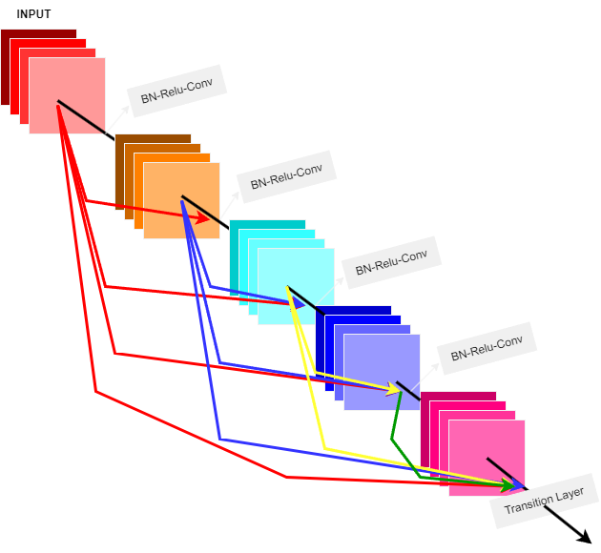
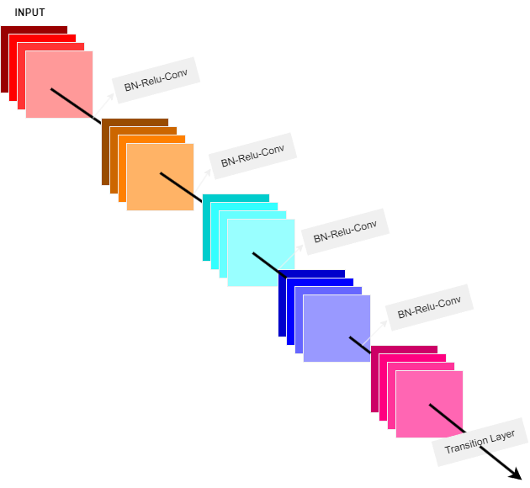
DISCUSSION
Roll No.-21MTechIT05
The key idea is to improve the flow of information and gradient through the network by connecting each layer to all the subsequent layers in a feed forward manner.
ResNet used an additive method i.e they takes previous output as an input for the next layer
Fig. DenseNet Structure
Fig. ResNet Structure
Notes:
as the number of layers in the CNN increase, i.e. as they get deeper, the 'vanishing gradient' problem arises.
This means that as the path for information from the input to the output layers increases, it can cause certain information to 'vanish' or get lost which reduces the ability of the network to train effectively.
DenseNets resolve this problem by modifying the standard CNN architecture and simplifying the connectivity pattern between layers.
In a DenseNet architecture, each layer is connected directly with every other layer, hence the name Densely Connected Convolutional Network
The key idea is to improve the flow of information and gradient through the network by connecting each layer to all the subsequent layers in a feed forward manner
It is very similar to ResNet. ResNet used an additive method i.e they takes previous output as an input for the next layer
All the layers are interconnected directly and used the concept of feature reusing which help to reduce the number of parameters.

Slide 27
DISCUSSION
Roll No.-21MTechIT05
Improved DenseNet-121
Depth-wise convolution is a popular approach for reducing the parameters and improving the computational and representational efficiency.
The operation uses particular filters for each of the input channels and then the outputs are combines with the help of a point-wise 1 x 1 convolution.
In deep learning, regularization is a technique used to prevent overfitting and improve the generalization capability of a model.
Regularization methods introduce additional constraints or penalties to the loss function during the training process.
DenseBlock
DenseBlock
DenseBlock
DenseBlock
7x7 Conv
Regularizer, l2
6x (1x1 D.W Conv, 3x3 Conv)
1x1 Conv
2x2 AvgPool
6x (1x1 D.W Conv, 3x3 Conv)
1x1 Conv
2x2 AvgPool
6x (1x1 D.W Conv, 3x3 Conv)
1x1 Conv
2x2 AvgPool
6x (1x1 D.W Conv, 3x3 Conv)
Classification Layer
INPUT
3x3 MaxPool
Transition Layer
Transition Layer
Transition Layer
Fig. Improved DenseNet-121 Model Architecture
Notes:
Dense Block - Each dense block is composed of several convolutional layers with the same number of filters.
The output feature maps of all preceding layers are concatenated and used as the input to each layer within the dense block.
This creates densely connected layers, which leads to a very deep and narrow architecture, with a high degree of feature reuse and reduced redundancy.
2. Transition Layer- Reduce no. of features maps (by combine 1x1 conv), Down sample the spatial dimension of the feature maps (2x2 avg pool layer)

Slide 28
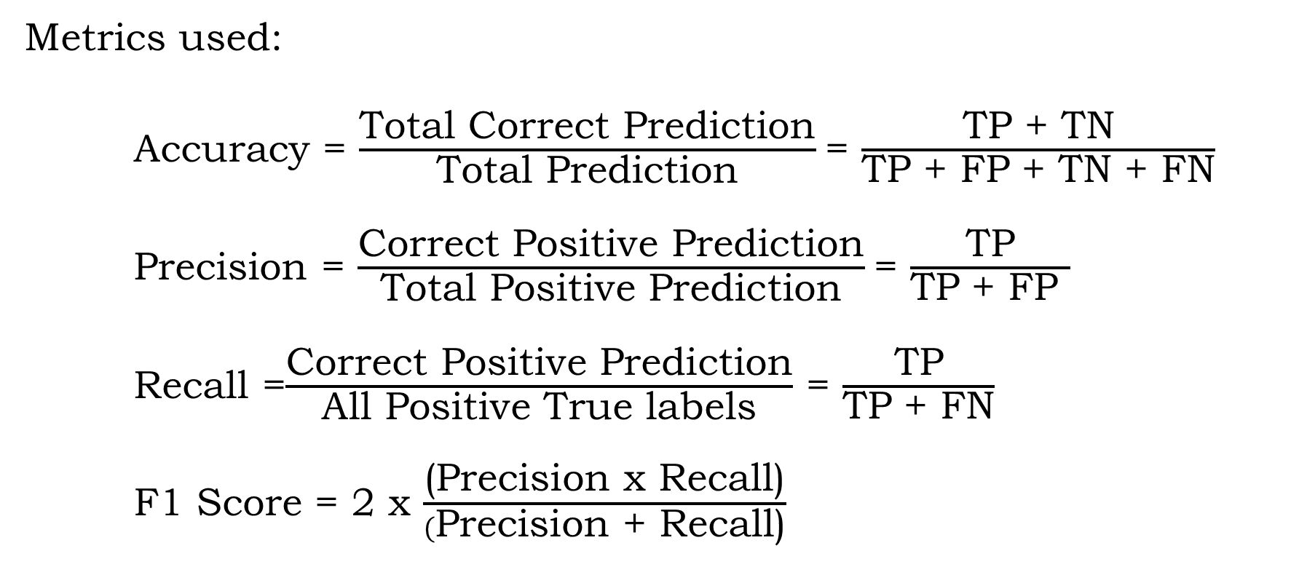
Roll No.-21MTechIT05
EXPERIMENTAL RESULT & ANALYSIS
Metrics used:
Accuracy = $\frac{\text{Total} \text{C}\text{orrect} \text{P}\text{rediction}}{\text{Total} \text{P}\text{rediction}}$= $\frac{\text{TP}\text{ + }\text{TN}}{\text{TP}\text{ + }\text{FP}\text{ + }\text{TN}\text{ + }\text{FN}}$
Precision = $\frac{\text{Correct} \text{P}\text{ositive} \text{P}\text{rediction}}{\text{Total} \text{P}\text{ositive} \text{P}\text{rediction}}$= $\frac{\text{TP}}{\text{TP}\text{ + }\text{FP} }$
Recall =$\frac{\text{Correct} \text{P}\text{ositive} \text{P}\text{rediction}}{\text{All} \text{P}\text{ositive} \text{T}\text{rue} \text{labels}}$ = $\frac{\text{TP}}{\text{TP} \text{+} \text{FN}}$
F1 Score = 2 x $\frac{\text{(}\text{P}\text{recision} \text{x} \text{Recall}\text{)}}{(\text{P}\text{recision} \text{+ }\text{Recall}\text{)}}$
Notes:
Metrics used for evaluate the results

Slide 29
Roll No.-21MTechIT05
RESULT ANALYSIS
Sl.No | Model | Accuracy | Precision | Recall | F1-Score
1 | LeNet | 0.58 | 0.51 | 0.53 | 0.50
2 | AlexNet | 0.78 | 0.77 | 0.77 | 0.75
3 | VGG-16 | 0.89 | 0.83 | 0.85 | 0.84
4 | VGG-19 | 0.82 | 0.77 | 0.77 | 0.77
5 | MobileNet | 0.92 | 0.91 | 0.91 | 0.91
6 | MobileNet-V2 | 0.85 | 0.84 | 0.85 | 0.84
7 | XceptionNet | 0.67 | 0.72 | 0.63 | 0.62
8 | ResNet50 | 0.82 | 0.76 | 0.77 | 0.76
9 | ResNet152-V2 | 0.92 | 0.91 | 0.92 | 0.91
10 | DenseNet-121 | 0.95 | 0.93 | 0.94 | 0.93
11 | Improved DenseNet-121 | 0.9864 | 0.985 | 0.983 | 0.983

Slide 30
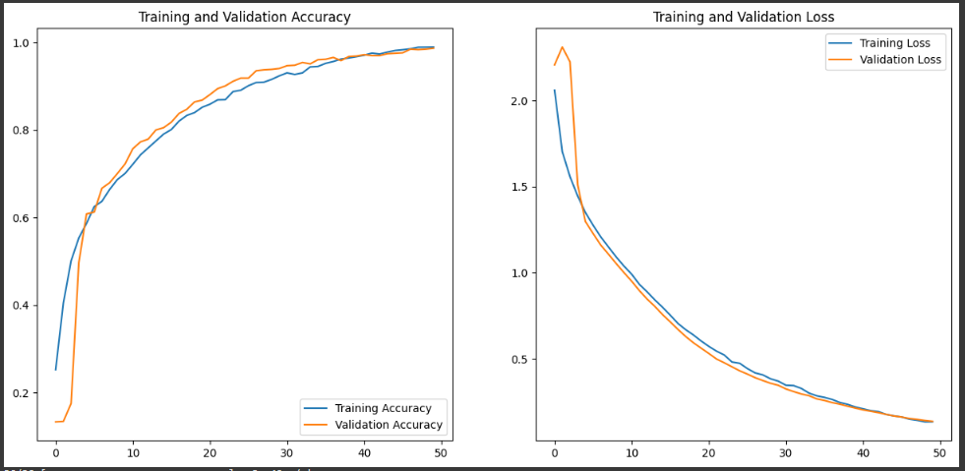
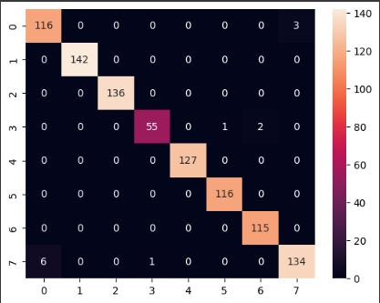
Roll No.-21MTechIT05
RESULT ANALYSIS
Confusion Matrix and Accuracy-Loss Result of Improved DenseNet-121
Fig. Training and Validation Accuracy vs Training and Validation Loss
Fig. Confusion matrix of the classifier

Slide 31
Roll No.-21MTechIT05
CONCLUSION
In conclusion, this study explored the performance of 10 different DNN models, including LeNet, AlexNet, VGG-16, VGG-19, MobileNet, MobileNet-V2, ResNet-50, ResNet152-V2, XceptionNet, and DenseNet-121, on SAR image classification using the MSTAR SAR dataset.
The results show that DenseNet-121 outperformed the other models, achieving an accuracy of 95%.
DenseNet-121 model uses the concept of feature reusing by connecting the output of each layer to the input of all other succeeding layers in forwarding directions.
To further increase the model performance, a modified architecture of the model where regularizer, l2 is used in the model and depth-wise convolution was added inside the dense block. It is observed that the modified model out performed than the original DenseNet-121 model.
Notes:
Although DenseNet-121 achieved a high accuracy of 98.64%, exploring ensemble methods can be a potential avenue for further improvement.
Ensemble methods combine multiple models to make predictions, often resulting in improved performance
Further investigation into advanced regularization techniques can be valuable

Slide 32
REFERENCES
Roll No.-21MTechIT05
[1] D. E. Dudgeon and R. T. Lacoss, “An overview of automatic target recognition,” The Lincoln Laboratory Journal, vol. 6, no. 1, pp. 3–10,1993.
[2] N. Kumbasar, A. N. Omeroglu, and H. M. A. Mohammed, “Classification of images obtained by sar (synthetic aperture radar) data,” ISASE2018, p. 203, 2018.
[3] A. K. Sharma, “Nisar–joint nasa-isro mission detecting tiny changes on earth’s surface,” 2022.
[4] M. Kirscht and C. Rinke, “3d reconstruction of buildings and vegetation from synthetic aperture radar (sar) images.,” in MVA, pp. 228–231, 1998.
[5] Albawi, S., Mohammed, T.A., Al-Zawi, S., 2017. Understanding of a convolutional neural network. In: 2017 International Conference on Engineering and Technology (ICET), Ieee, pp. 1–6.
[6] Jia, Zhai, et al. "A deep learning fusion recognition method based on SAR image data." Procedia computer science 147 (2019): 533-541
[7] Nida Kumbasar, Asli Nur Omeroglu, Hussein Mahmood Abdo , Emin Argun Oral, Ibrahim Yucel Ozbek. Classification of Images Obtained by SAR (Synthetic Aperture Radar) Data

Slide 33
REFERENCES
Roll No.-21MTechIT05
[8] Hasni Anas, Hasni, et al. "Deep learning for sar image classification." Intelligent Systems and Applications: Proceedings of the 2019 Intelligent Systems Conference (IntelliSys) Volume 1. Springer International Publishing, 2020.
[8] Ameta, Abhishek, Vinayak Singh, and Veena Devi SV. "A Convolutional Neural Network Based Approach for SAR Image Classification of Vehicles.“
[9] C. Coman et al., “A deep learning sar target classification experiment on mstar dataset,” in 2018 19th international radar symposium (IRS), pp. 1–6, IEEE, 2018.
[10] Y. Wang, Y. Zhang, H. Qu, and Q. Tian, “Target detection and recognition based on convolutional neural network for sar image,” in 2018 11th International Congress on Image and Signal Processing, BioMedical Engineering and Informatics (CISP-BMEI), pp. 1–5, 2018.
[11] Hazarika, Ruhul Amin, Debdatta Kandar, and Arnab Kumar Maji. "An experimental analysis of different deep learning based models for Alzheimer’s disease classification using brain magnetic resonance images." Journal of King Saud University-Computer and Information Sciences 34.10 (2022): 8576-8598.

Slide 34
THANK YOU
+

